Slide 1

PharmaHacks 2023
Injoy Challenge IBS Food Group Identification using XGBoost Learning
Group Members: Punyaja Mishra, Devashish Kapoor, Rachit Saini, John Philip

Slide 2
Question statement?
We are trying to figure out the link between food and gastrointestinal symptoms for individuals with Irritable Bowel Syndrome (IBS). To achieve this, we need to accurately predict the symptom score and be able to explain the contribution of each food to the final prediction for each individual user.
Although each user records their diet and symptoms, the dataset is limited with only a few data points per user. To simplify the data, the food data is combined into broader categories like FODMAP, gluten, and wheat, which can lead to multicollinearity.

Slide 3
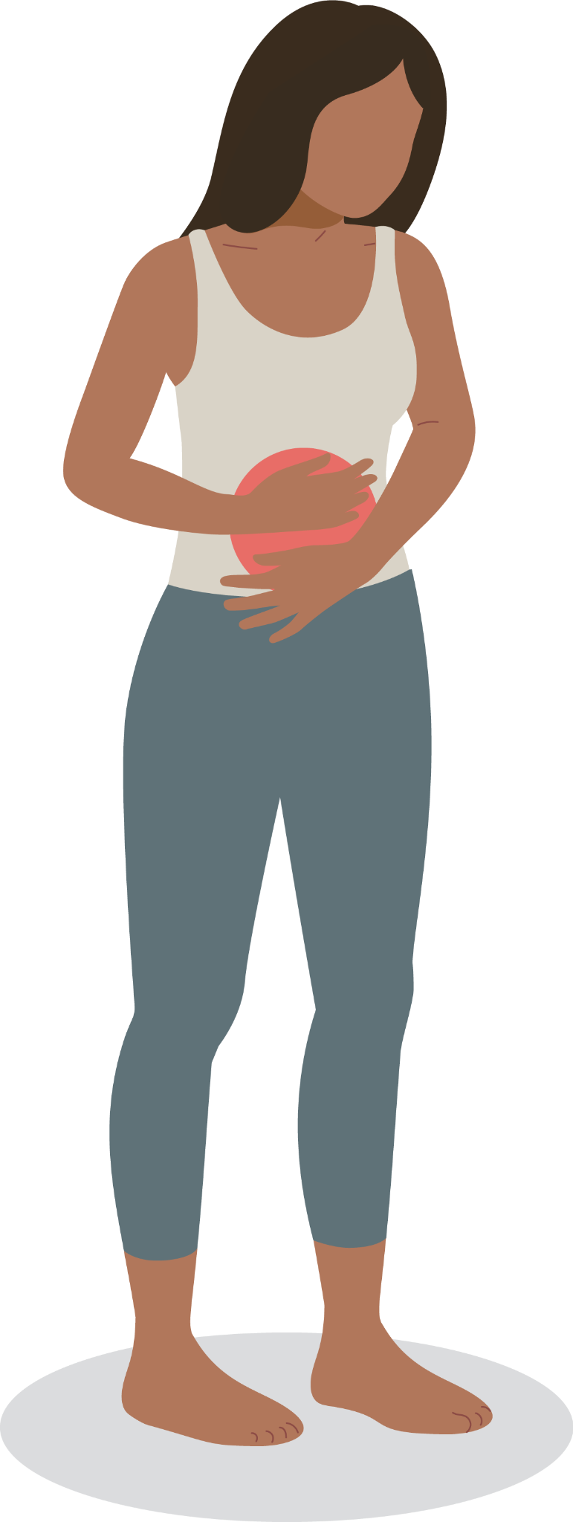
Purpose of the simulation - What is Irritable Bowel Syndrome (IBS)
Irritable Bowel Syndrome (IBS) is a common functional gastrointestinal disorder that affects a significant portion of the population. The primary symptoms of IBS include abdominal pain, bloating, constipation, and diarrhea. The precise cause of IBS is not yet fully understood,but it is believed to be related to a combination of genetic, environmental, and lifestyle factors.

Slide 4
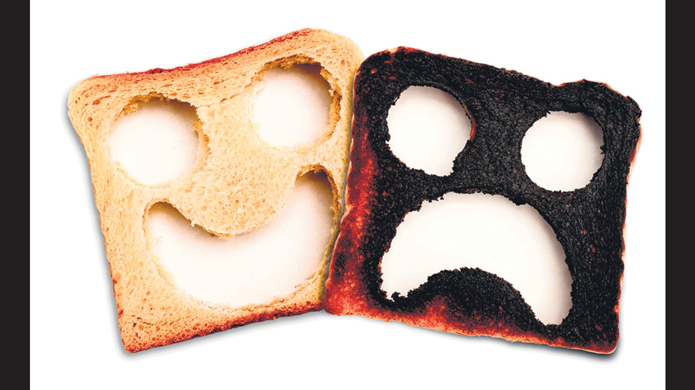
Purpose of the simulation
The purpose behind the project is to try to note the food that was consumed before the individual experienced symptoms and food that didn't cause any symptoms at all and then try to find a correlation between the symptom value and a the different food types. By doing this we try to narrow down the food types that should be avoided specific to the individual. We went ahead and from a number of cases found the most food type that came out to be a individual food type that should be avoided in most cases.

Slide 5
Datasets Provided
We were given the following user data files:
Data.csv - A list food groups that individual 50 users consumed when they believed to experience IBS symptoms along with the symptom value
Food_hierarchy.csv - A table of parent-child food group relationships that represents how several of the food groups may be a children of another food group
Food_symptom_relationship_strength.csv - A table representing how each food column contributes to the user’s symptoms

Slide 6

Simulation Language and Libraries Selected
Python
Numpy
Shap
Sklearn
Matplotlib.pyplot
Pandas
Xgboost
Statsmodel

Slide 7

How we approached this problem
We analyzed the data provided to make an initial assumption for the data points where the symptom values are zero which meant that selected user had no health issues
Next, we found the correlation between different food types and the severity of the symptoms of Irritable Bowel Syndrome (IBS) to see which foods might contribute to the development of IBS in the long run
Then, we filtered the data into X (food groups) and Y(symptom value) segments to train a multilinear regression using XGBoost
Finally, we used SHAP values to determine how each food group contributes to the model’s prediction and represent in the form of a data table, bar chart and extremities chart

Slide 8
Conceptual Model
Out of the datasets that was provided to us we decided on using just data.csv as not much context was provided about the data in the other two datasets.
Input Data:
Food Categories- 20 food categories were signified labeled as ‘F1’ to ‘F20’ with numeric values for each specific food category, which meant amount of serving consumed.
F1 = 4, implied 4 units of Food Category F1 was consumed for that data point
Symptom Value - A measure of symptoms experienced by the user per data point.
‘0’ symptom value = No symptoms

Slide 9
Assumptions
A lot of assumptions were taken into consideration based on which we decided our algorithms and narrowed down to using a single dataset.
For the data.csv dataset, there was no information provided on what the information provided meant or how was the different values were quantified. As the method of receiving these values werent mentioned, we assumed the symptomatic value above zero meant a symptom was seen and if it was below zero, it showed positive effects over IBS.
For food hierarchy, as there was no documentation provided with the food types we thought on not using these, as it meant replacing the occurrence of parent food type with child ones. We avoided on doing so as there were some entries which showed complete contrasting results for some of the cases. From our cases we concluded F5 to be the food type leading to food causing trouble in most IBS cases, from the food hierarchy we can see that f3,f19,f10,f4 don't show no significant symptomatic value or cases where they can seem to effecting symptomatic value. From this observations we thought of not including food hierarchy.

Slide 10
Specification Model
We built 2 programs - foodUser.py and foodCollecitve.py
foodUser.py - The program generates a model that calculates the correlation between each food category and the symptom value for an Individual User
foodCollective.py - The program generated a model that aggregates the calculated correlations the food categories and the symptom value for all users to identify the Food Category with Highest and Lowest Correlation
Total Number of Users = 50 User_Number whose correlation values are calculated in foodUser.py = input from User in range (0,50) Number of Data Points per User = Varied per User (No certain Pattern as it was Patient Input Data)
Feature Selection = Spearman Correlation Machine Learning Algorithm Used = XGBoost

Slide 11
Spearman Correlation and XGBoost
Spearman Correlation
We implemented the Spearman Correlation method for feature selection to identify the Food Categories that has the highest effect on the Symptom Value Per User.
Output : list of food categories
XGBoost
To find correlation values, we needed a regression model
XGBoost was our choice of ML Algorithm over other regression models because of its ability to consider multiple independent parameters

Slide 12
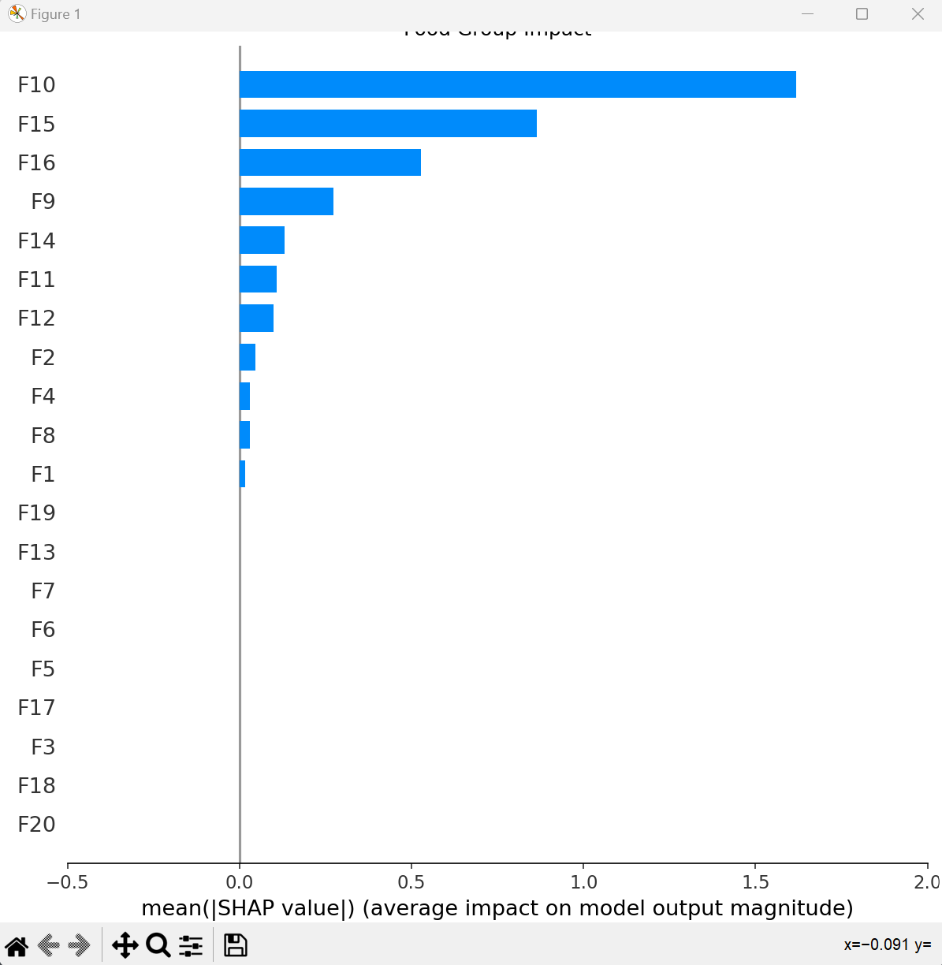
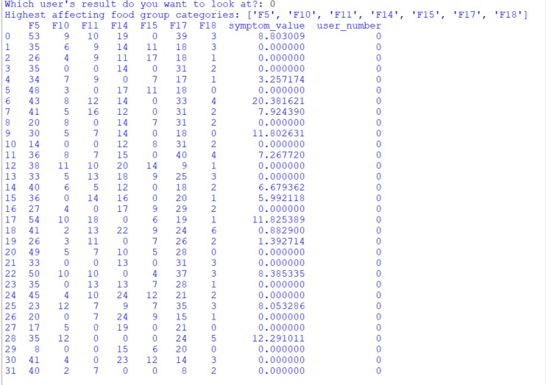
Simulation Run 1 - Individual User 0
High Correlation Categories

Slide 13
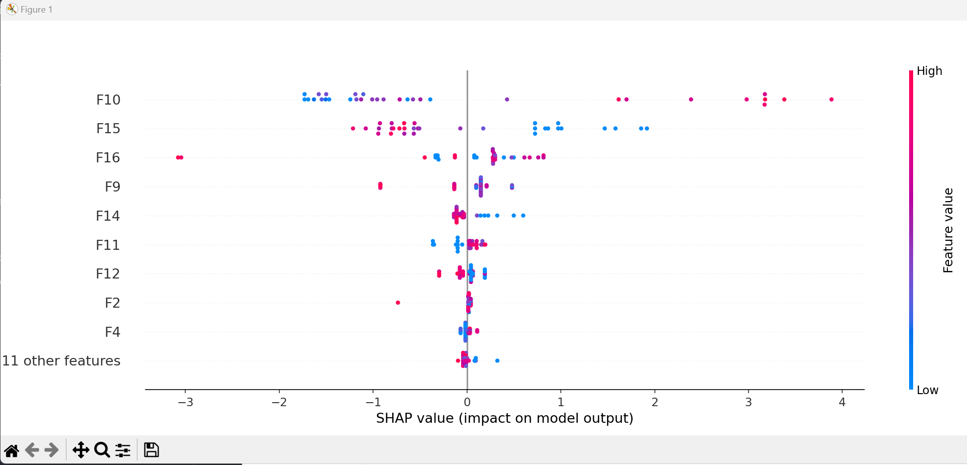
Simulation Run 1 - Individual User 0
Extremities Chart

Slide 14
Conclusion: Simulation Run 1 - Individual User 0
From the results table, bar chart and the extremities chart, we can easily identify the individual food groups that are assumed to cause IBS symptoms for the sample user 0.
The results table and the bar chart are an easy-to-understand visual of the highest food group correlations to the symptom value whereas the extremities chart helps the reader understand the severity level of a specific food group for a particular user.
Likewise, we can run this simulation for any individual user to determine the food groups that may be a cause of provoking IBS symptoms for that specific user.

Slide 15
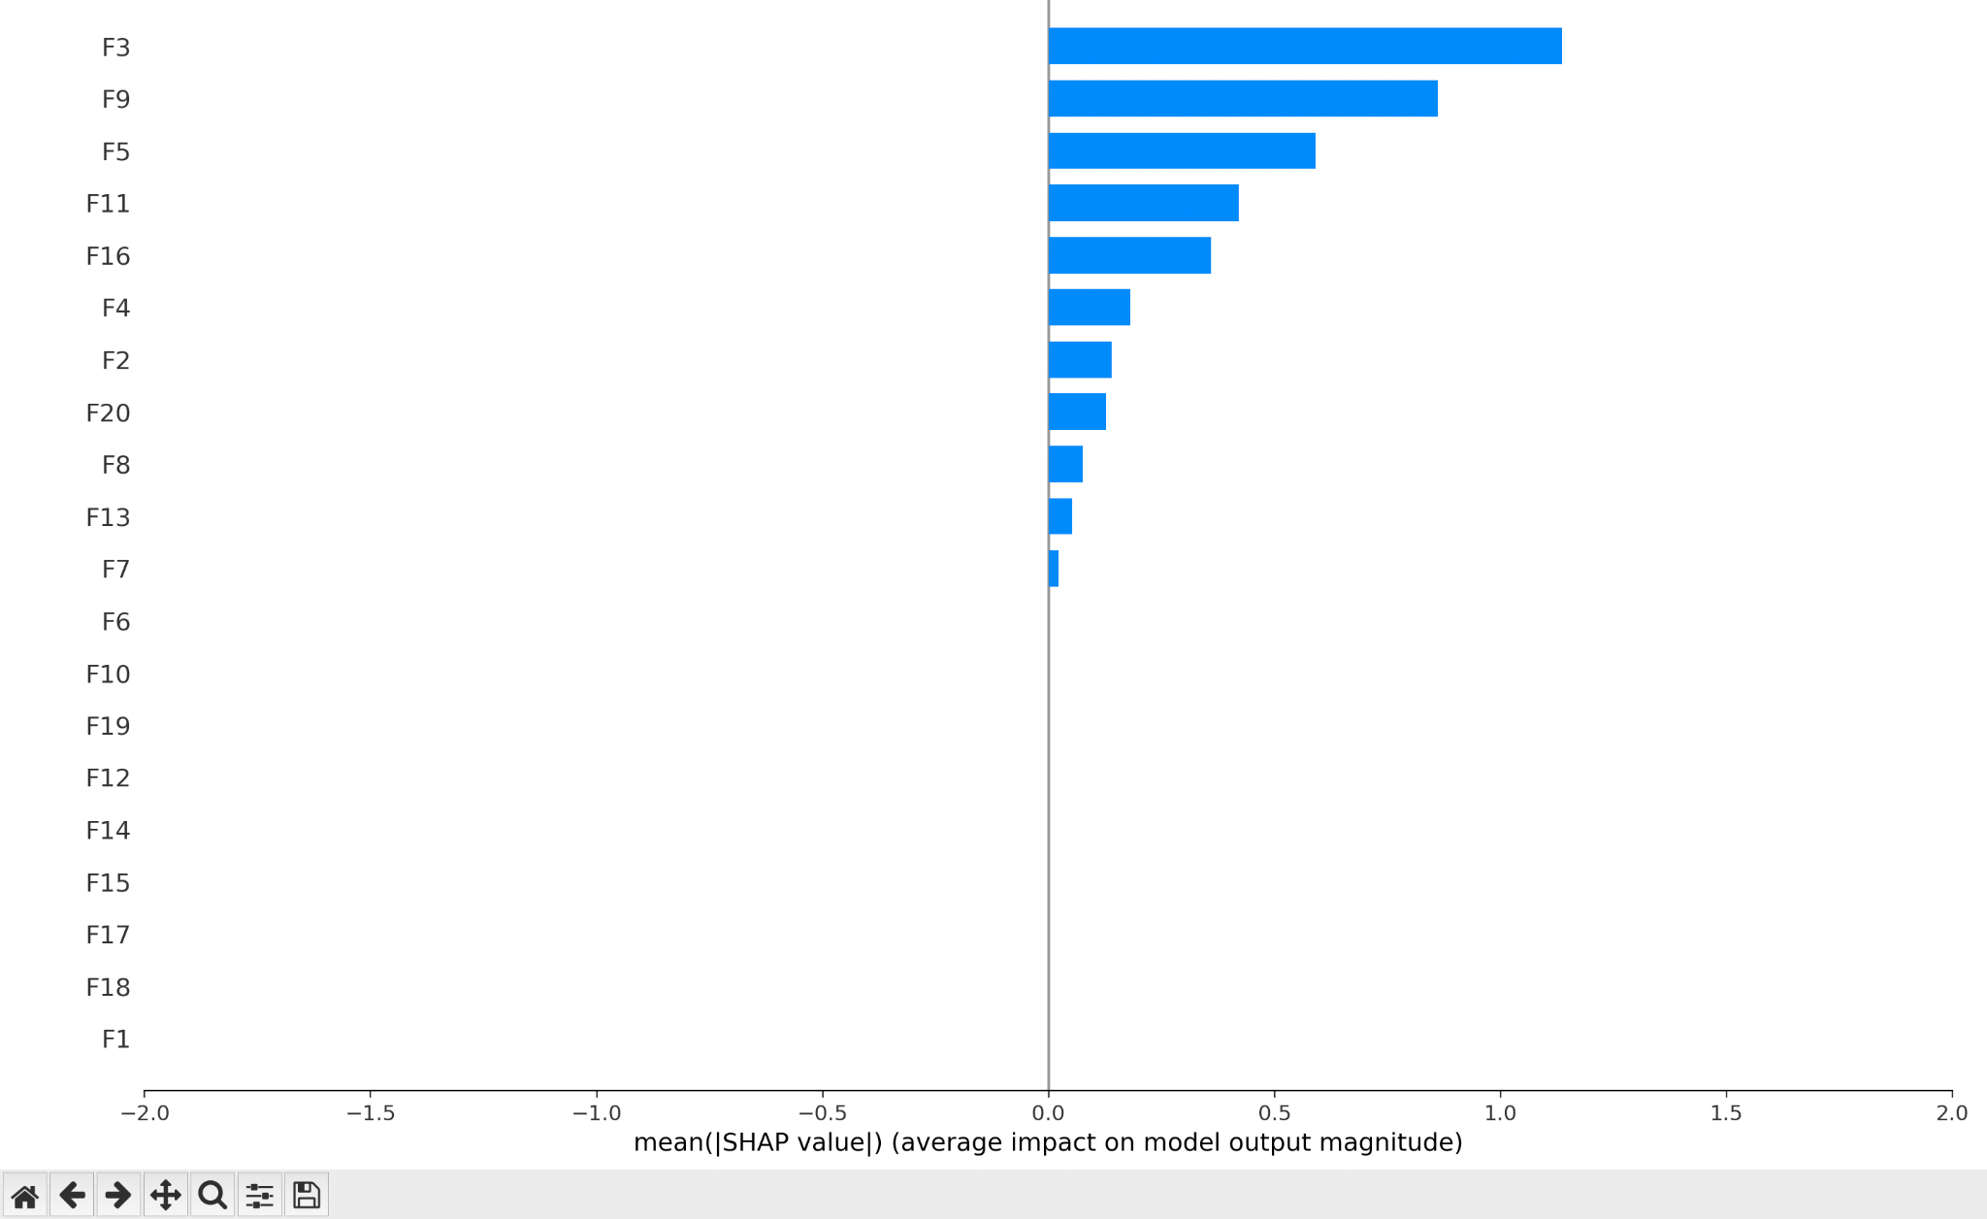
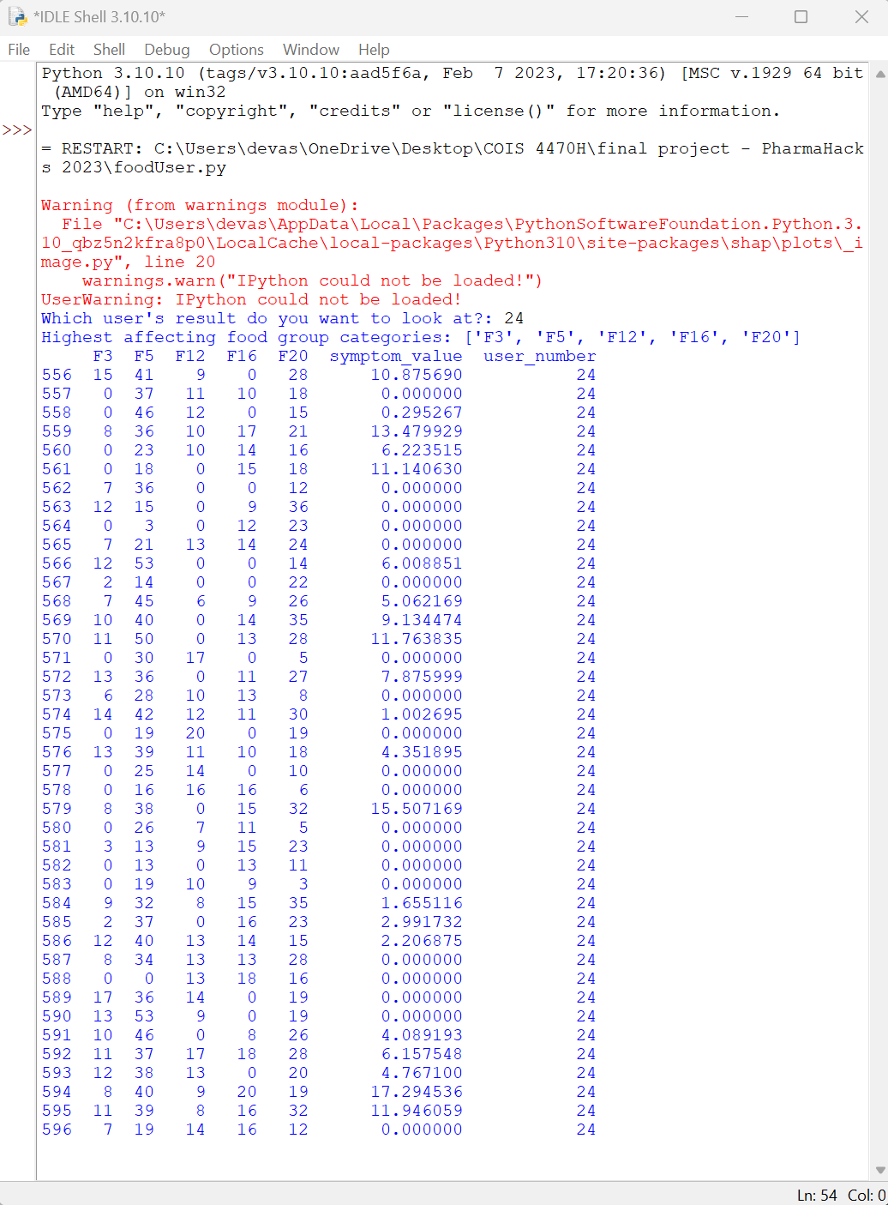
Simulation Run 2 - Individual User 24
High Correlation Categories

Slide 16
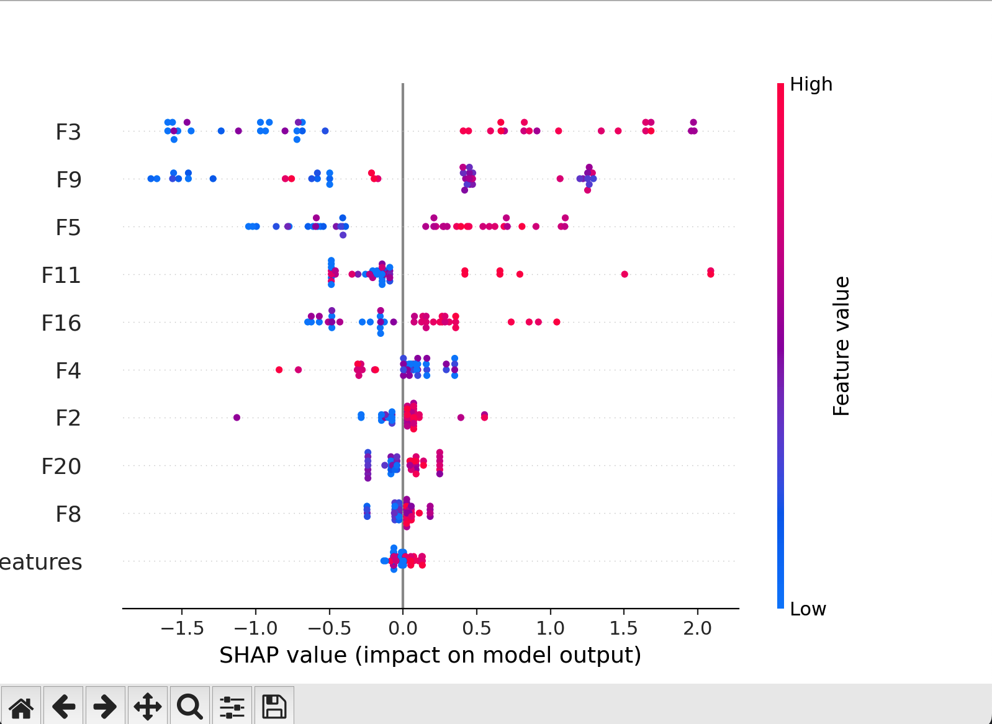
Simulation Run 2 - Individual User 24
Extremities Chart

Slide 17
Conclusion: Simulation Run 2 - Individual User 24
From the results table, bar chart and the extremities chart, we can easily identify the individual food groups that are assumed to cause IBS symptoms for the sample user #24.
Looking at the simulation result for user #24 we can see that the food that effects the user the most is food F3.
This can also be confirmed by the extremities map that show how much of an effect that food F3 has on the user.
Looking at the results tables, we can then tell the user the food groups they should avoid so as to prevent IBS.

Slide 18
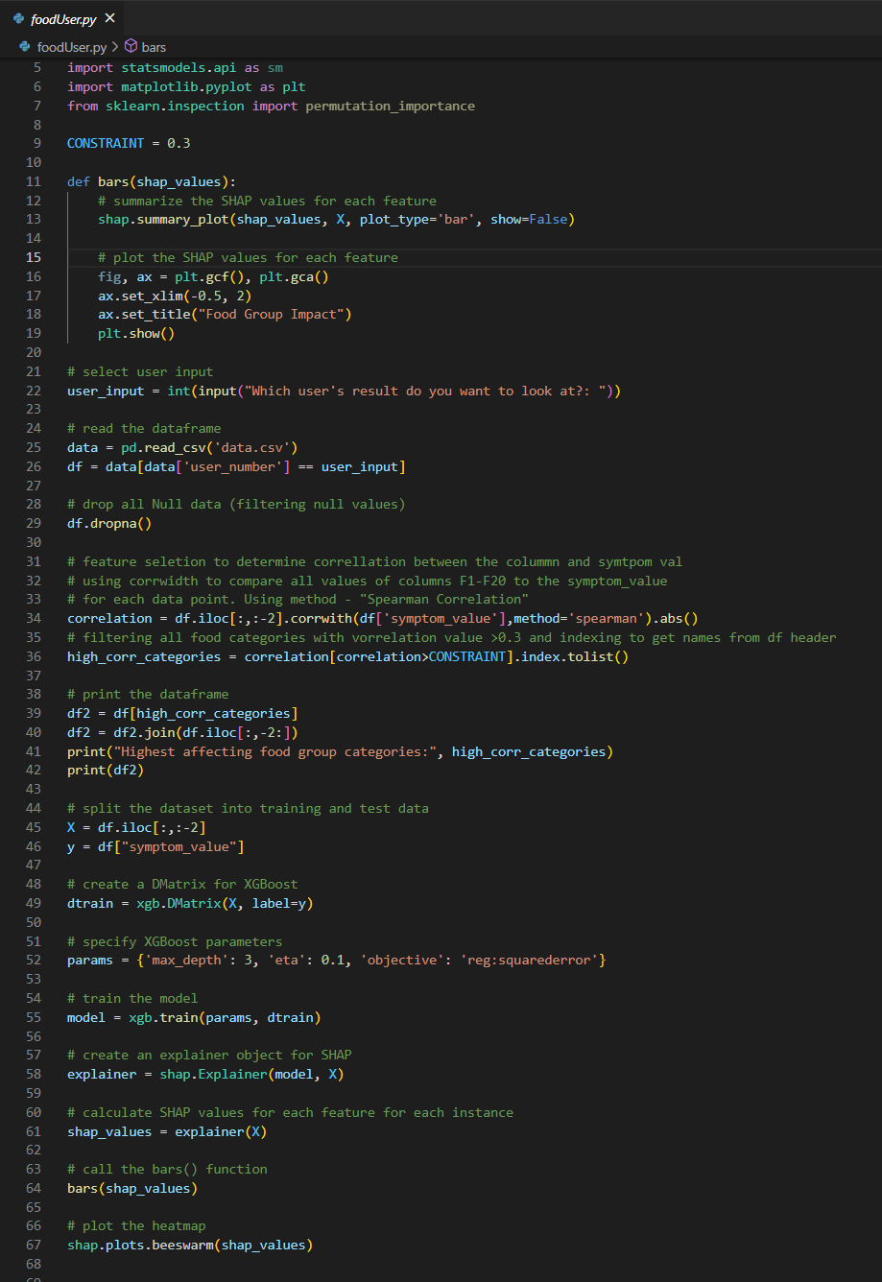
foodUser.py

Slide 19
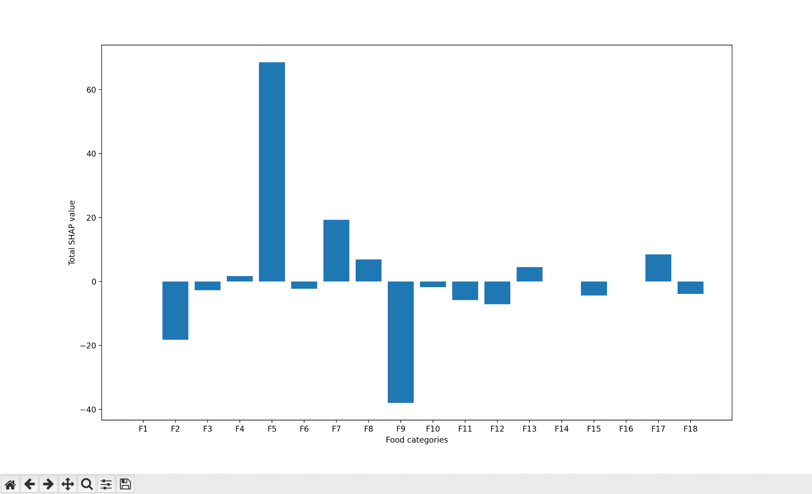
Simulation Run 3 - All Users
Correlation Values Per Food Category

Slide 20
Conclusion: Simulation Run 3 - All Users
From this simulation, we aim to find food groups that are likely to trigger IBS symptoms when consumed among a majority of the users. We use the entire data set of user entered data and we run create a model.
The results given state that the food group F5 is more likely to trigger symptoms of IBS whereas the food group F9 is the least likely to trigger symptoms of IBS across the dataset.
This also helps in analyzing the food hierarchy.This gives us an interesting insight into the parent child relationships. The basic assumption that if a parent food causes IBS symptom leads to child foods causing it is proven to be false as seen in the data. This proves that there is something deeper than just foods that causes IBS.

Slide 21
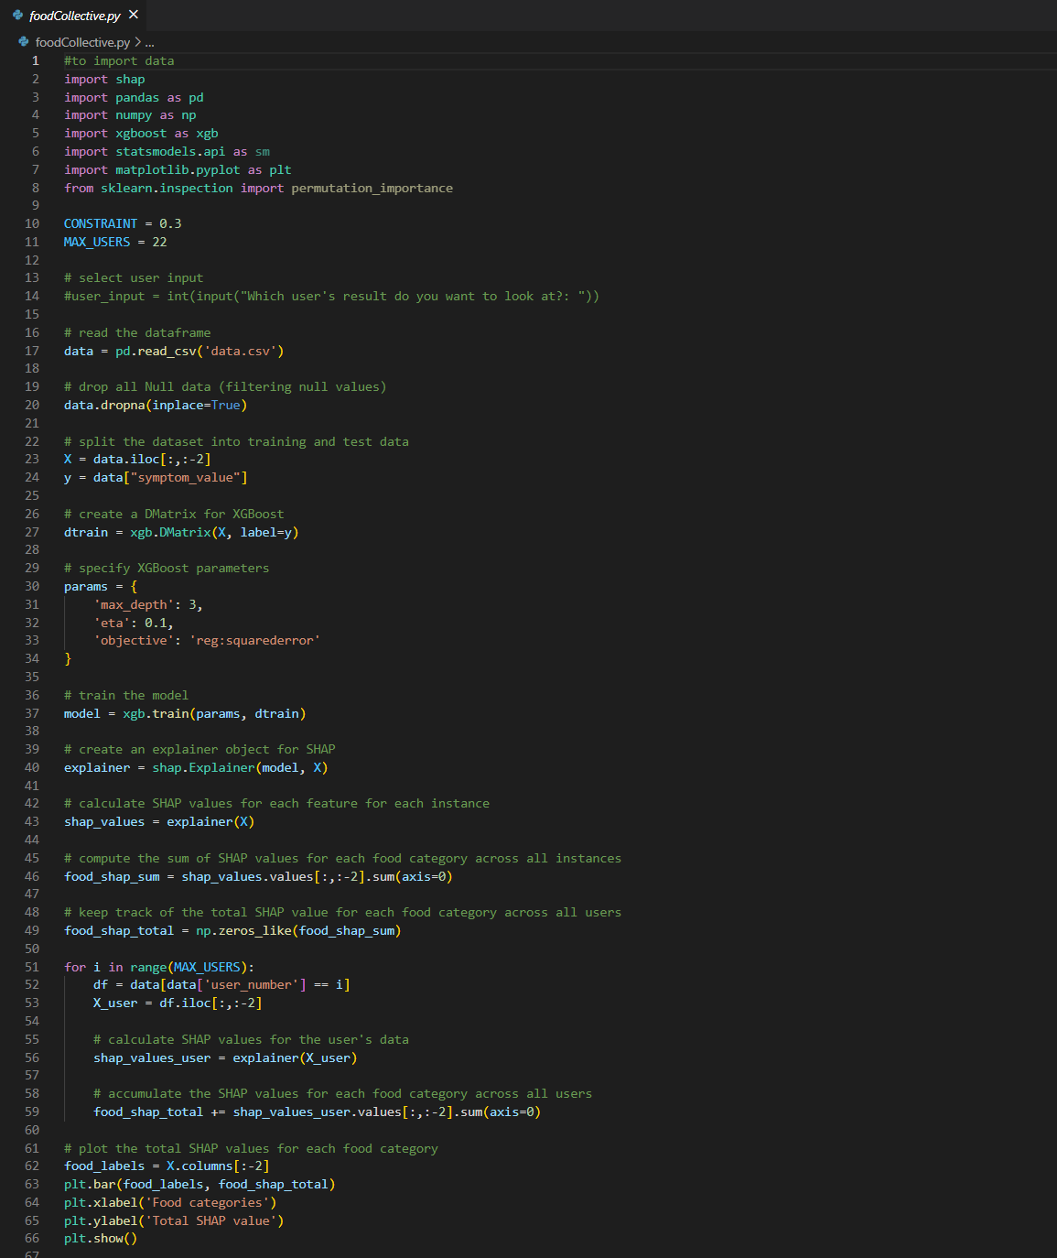
foodCollective.py

Slide 22
Comparison and discussion
After running the simulation and analyzing the results for each individual user, we can cross-verify our conclusion to the output of our collective model (foodCollective.py) of food group (F5) being the most contributing food category towards causing IBS symptoms and food group (F9) having the least impact on the IBS symptom value.
Following this cross verification, we can conclude that our outcomes from the two models are validated and can be used to draw conclusions when building a treatment plan for IBS patients.

Slide 23
Conclusion and Recommendation
We can expand this model to incorporate all food groups and their subcategories to identify which food categories become the common cause of provoking IBS in the human body at a larger scale.
The scope of this model can be expanded to determine food groups that provoke IBS symptoms within a specific region given the individual users’ food consumption data set(s)
We can also explore the implementation of the Food Hierarchy, which categorized food as Parent and its children, and investigate how they impact the correlation value based on their relationship.
Furthermore, this analysis can help research into decomposing the microbiological structure of food compounds and identifying which sugars or acids can potentially cause IBS symptoms.

Slide 24
References
Github Link (https://github.com/yencoder/PharmaHacks2023)
Scikit-learn library
StackOverflow
PharmaHacks Resource Kit (https://docs.google.com/document/d/1npsnEwplm6xE-mlHjcpUq4r5dROXyC-cbc48Vx-I5do/edit)

Slide 25
Thank you

